Slide 1

Greetings

Slide 2



Slide 3



Slide 4

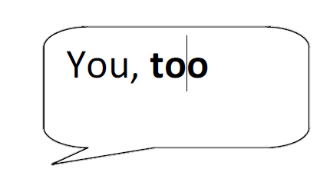

Slide 5



Slide 6
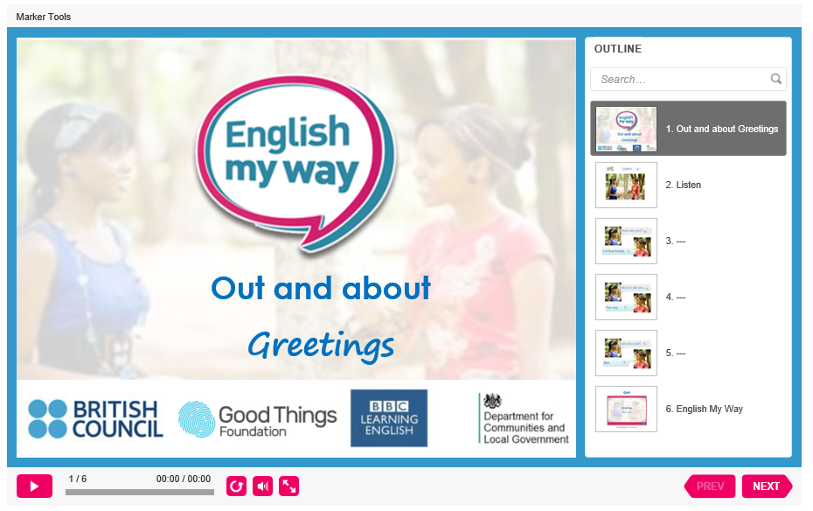
https://www.englishmyway.co.uk/topics/130/246

Slide 7
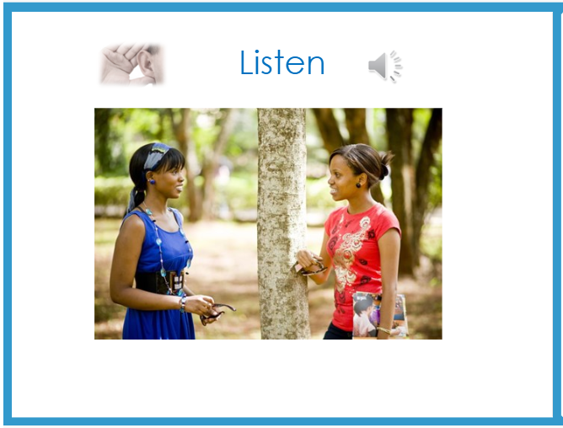

Slide 8
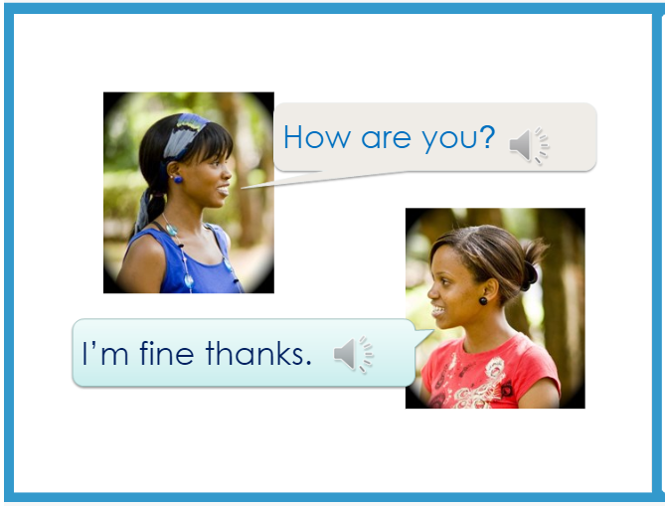

Slide 9
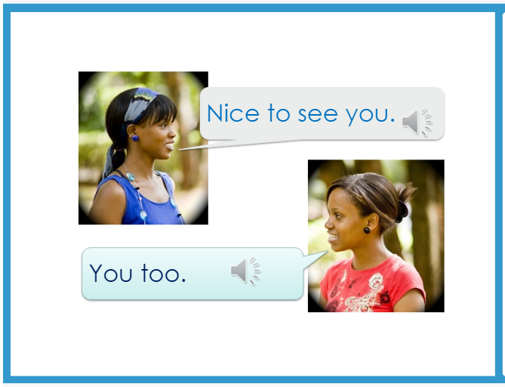

Slide 10


